Slide 1
28 – Clean Code – Design Patterns – Finite State Machines and State Patterns
Based on the CleanCoders videos by Uncle Bob Martin
Rupert Waldron

Slide 2
Finite State Machines
A finite state machine is a machine with a finite number of states
All computers have a finite number of states, therefore all computer programs are finite state machines
GUIs are good examples of where it can be useful to model the program as a finite state machine – Intellij – e.g. edit and refactor – greyed out menus

Slide 3
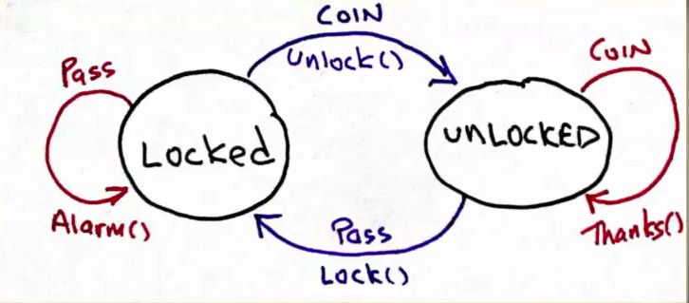
State Pattern – The Turnstile
The State Diagram
Transition
Transition
Given: The Turnstile is locked
When: A coin is inserted
Then: The Turnstile will go to the locked state
Transition
Action
State
State
Transition
Action
Action
Action

Slide 4
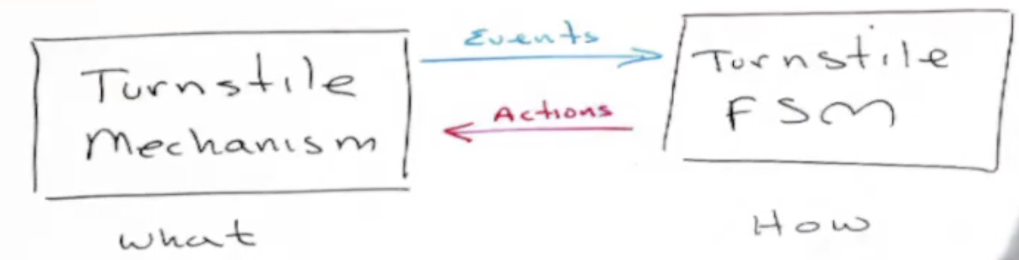
Finite State Machine(FSM) – What and How
The events and actions are what is being controlled – the FSM and the Turnstile can be kept completely separate from one another.
Separation of What from How – is critical to good software design
Failure to separate the what from the how leads to fragile software design – we previously talked about separating high-level policy from low level implementations – Dependency Inversion

Slide 5
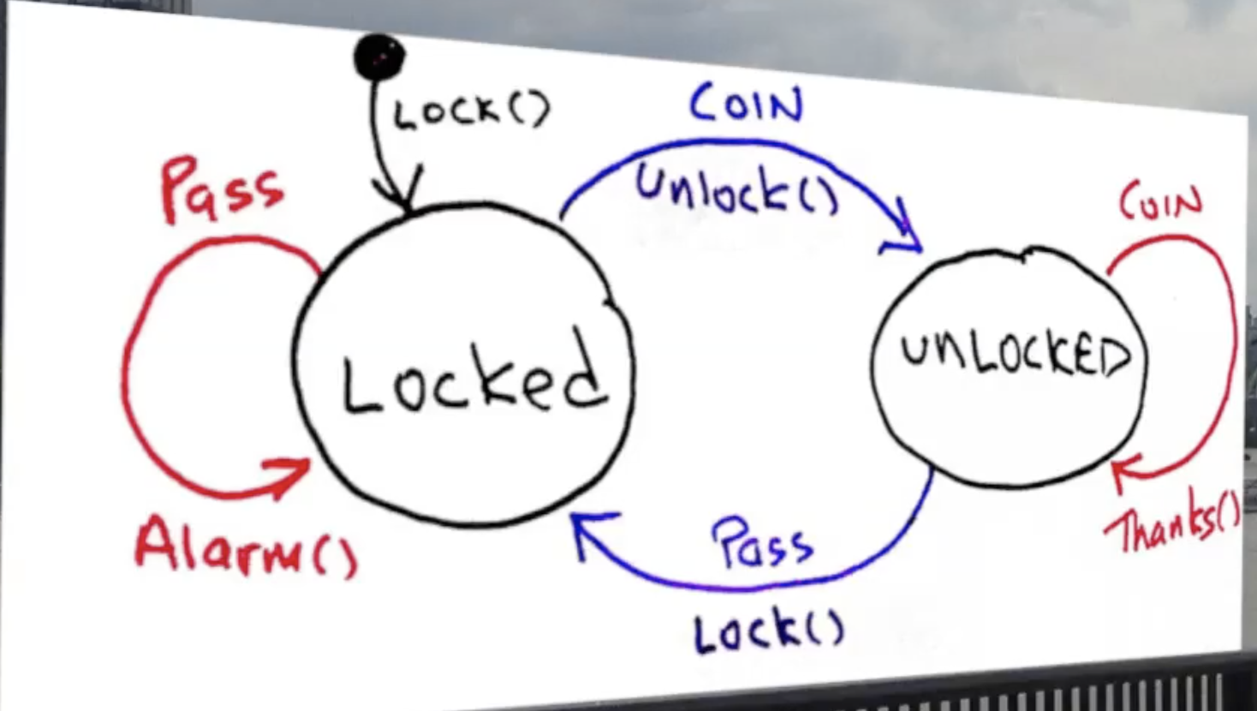
FSM – Initial State
Initial Pseudo State

Slide 6
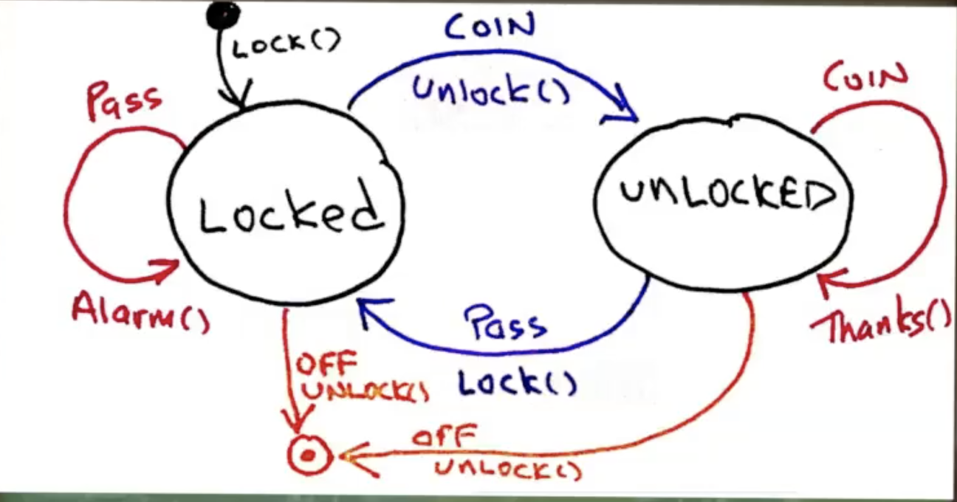
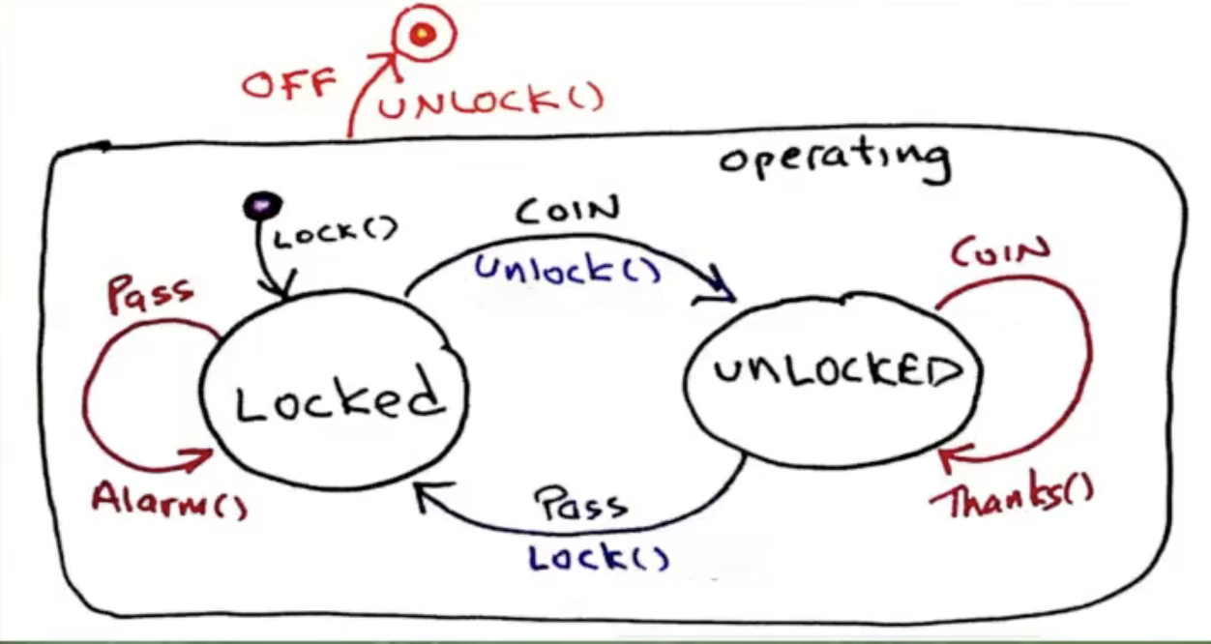
What happens when the turnstile is switched off?
The canonical form – The State Transition Diagram
Final Pseudo State

Slide 7
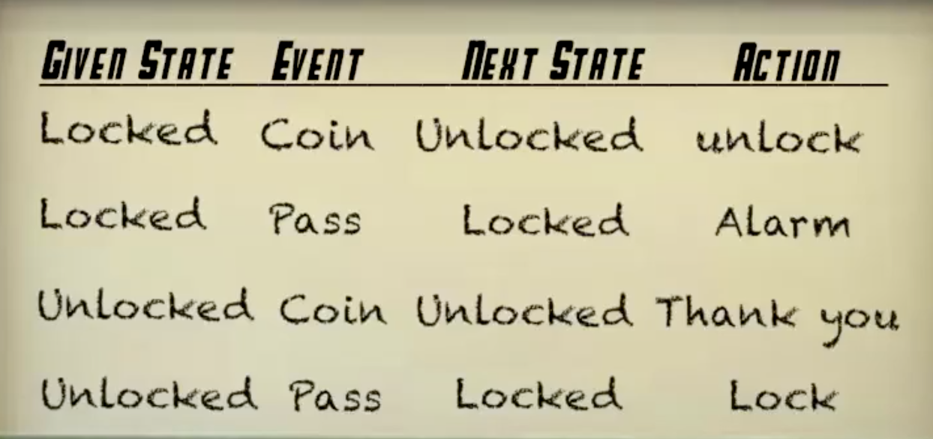
The State Transition Table
Given in Locked state When receive Coin event Then transitions to Unlocked state by performing unlock action

Slide 8
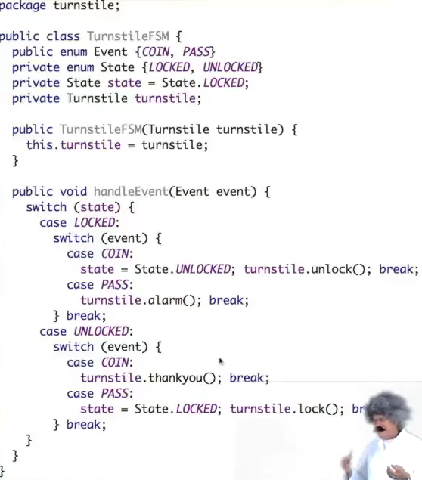
FSM – Let’s implement it
The nested switch case
Easy… but we only have 4 cases
Very fast

Slide 9
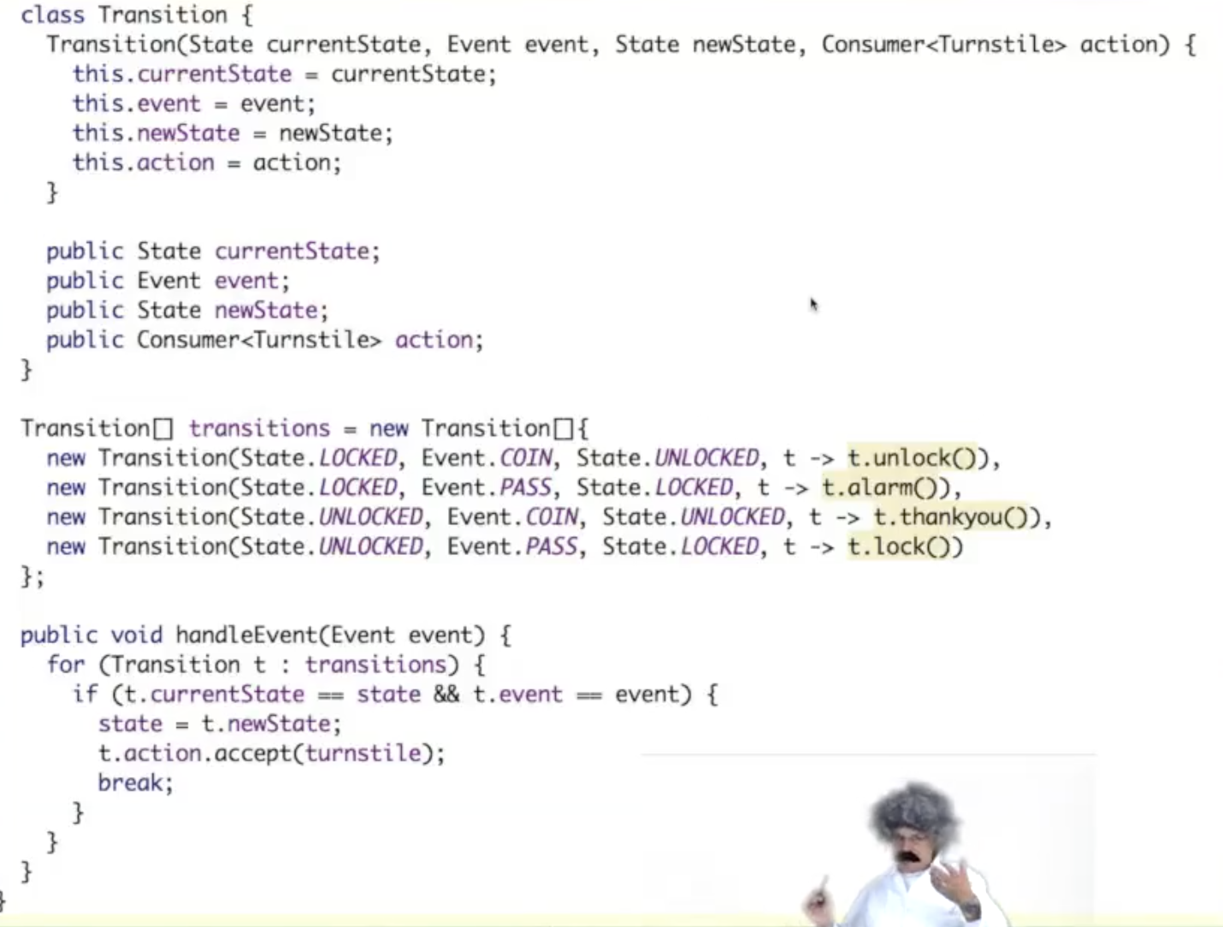
FSM – Let’s implement it
The table
Search through all transitions before finding the correct one

Slide 10
FSM – Let’s implement it
The table
Search through all transitions before finding the correct one
Very slow

Slide 11
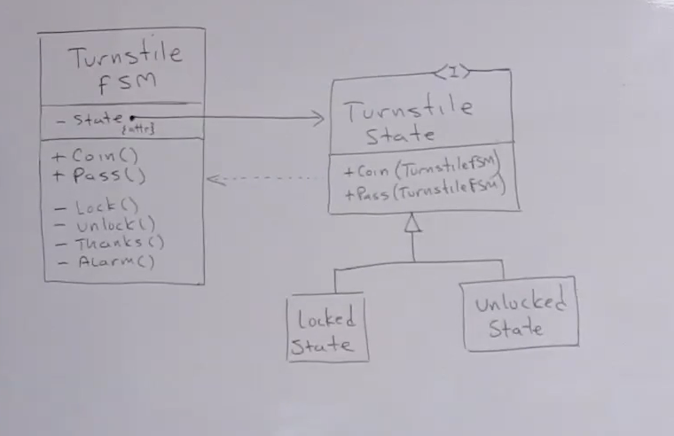
The State Pattern
Locked State and Unlocked State don’t hold any state so just need one of them for the length of the program…. Hmmm?

Slide 12
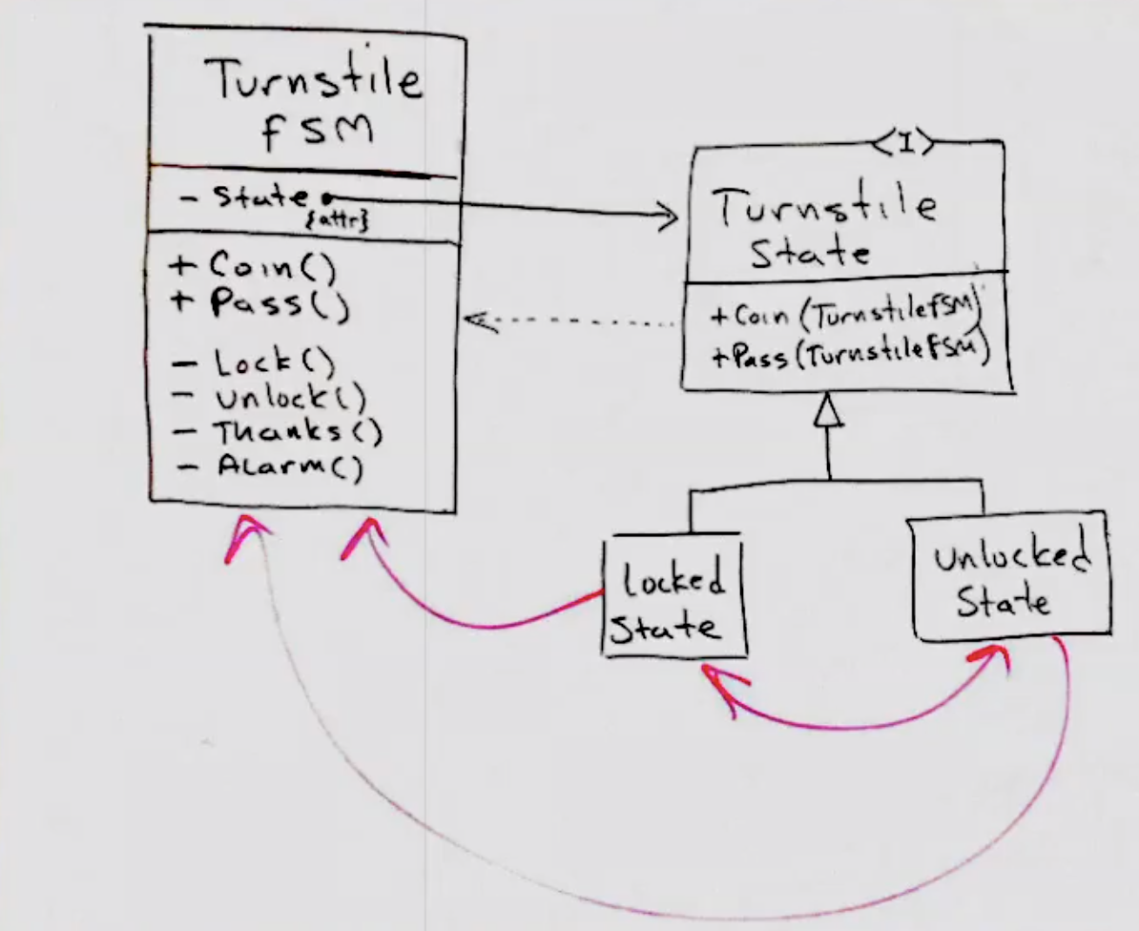
Coupling
Need to separate the logic from actions

Slide 13
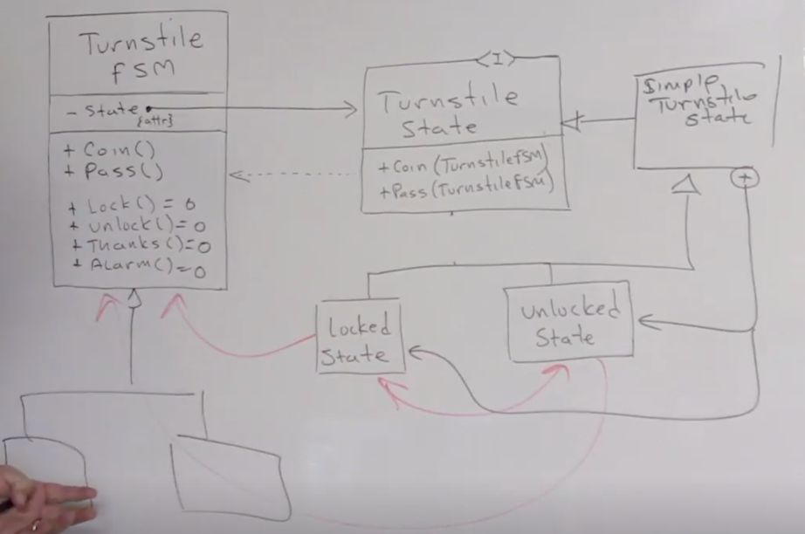
Using an enum
Nothing knows about the enum
Turnstile is now abstract so can have different implementations depending on different types of turnstyle

